Slide 1

SQL PROJECT Metro College
SUBMITTED TO -MARYAM KAZEMI
Submitted By – Naresh Kumar
Date : 12 Feb 2024

Slide 2
"Agenda"
Overview of SQL Projects
Database Design: Creation of 17 Tables
Implementation of Foreign Keys
Utilization of Functions
Executing Queries and Analyzing Results
Conclusion and Q&A

Slide 3
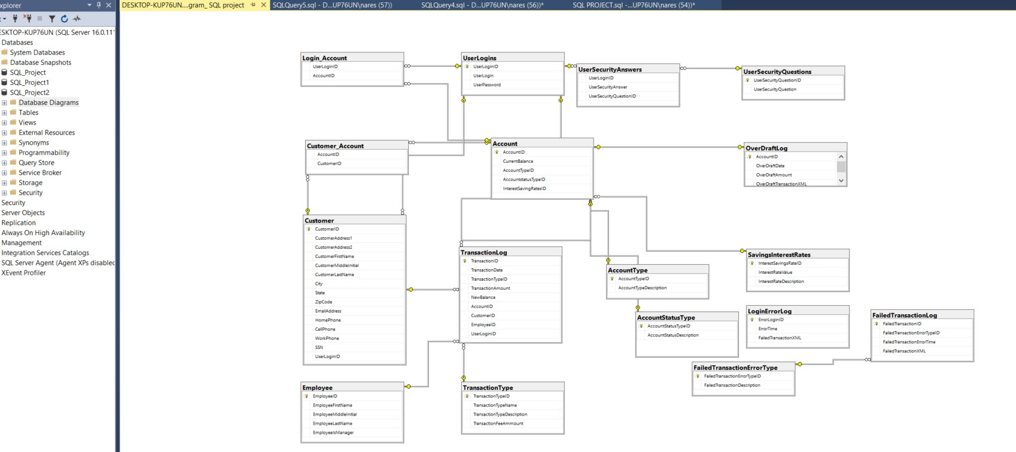
TABLE DIAGRAM

Slide 4
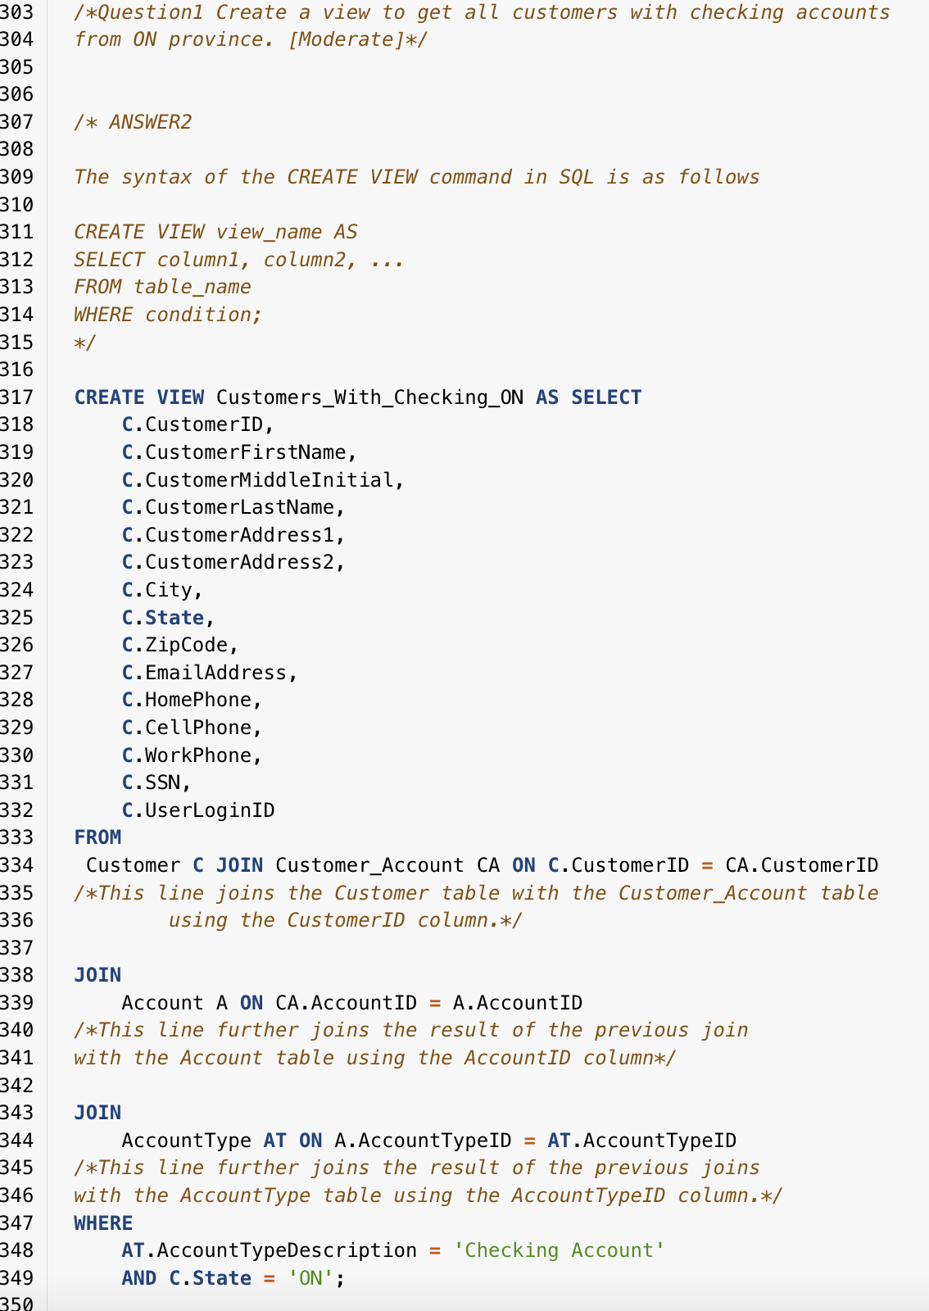
QUESTION ONE QUERY
RESULT

Slide 5
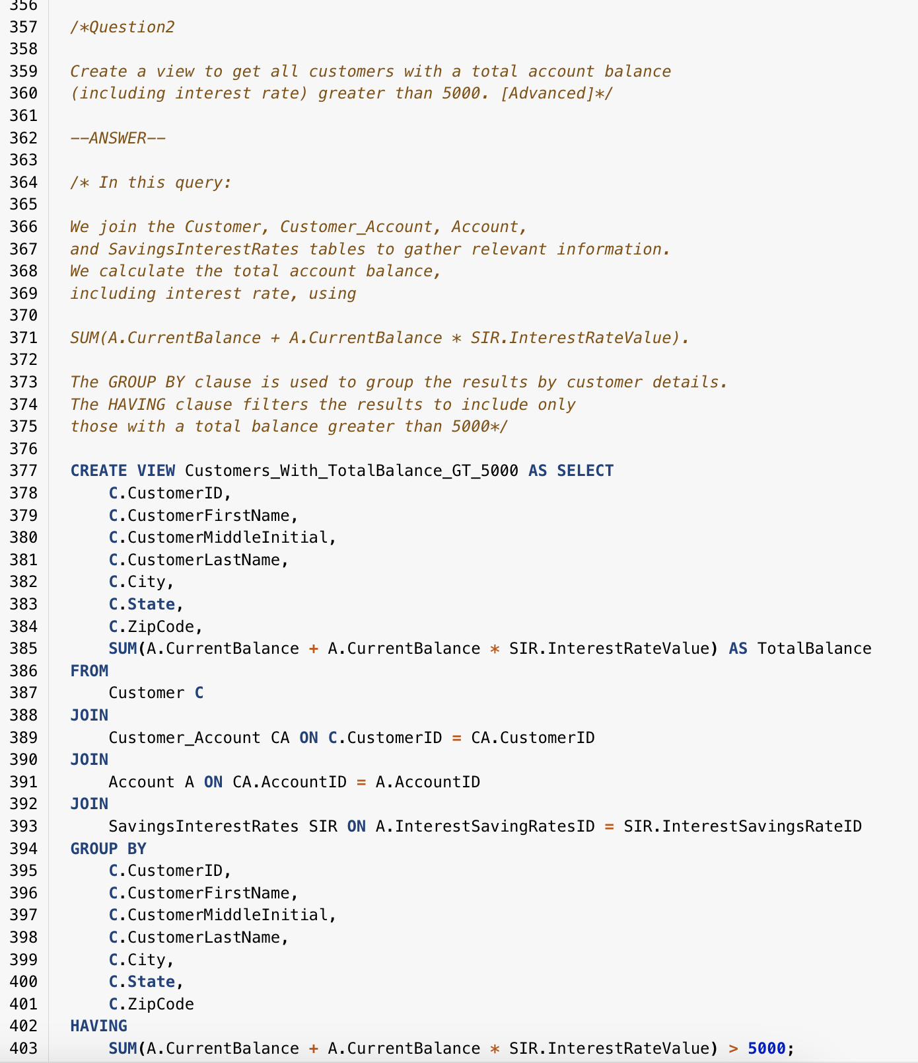
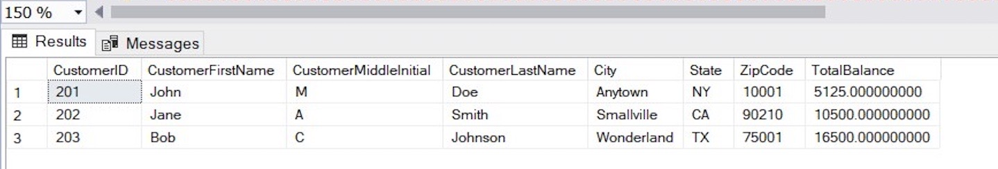
QUESTION TWO QUERY
RESULT

Slide 6
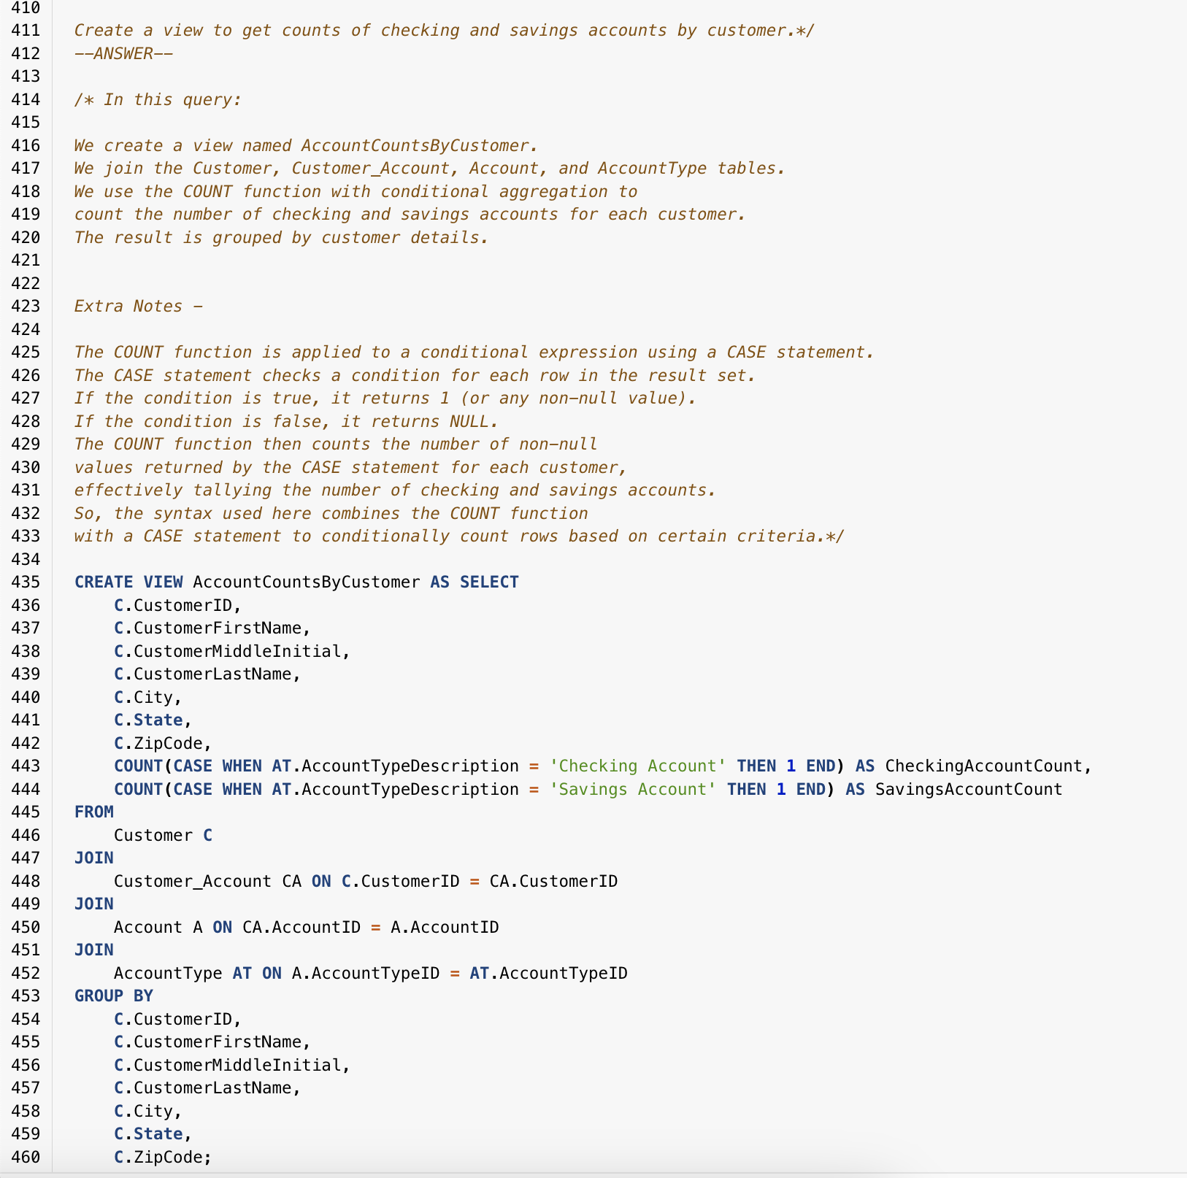
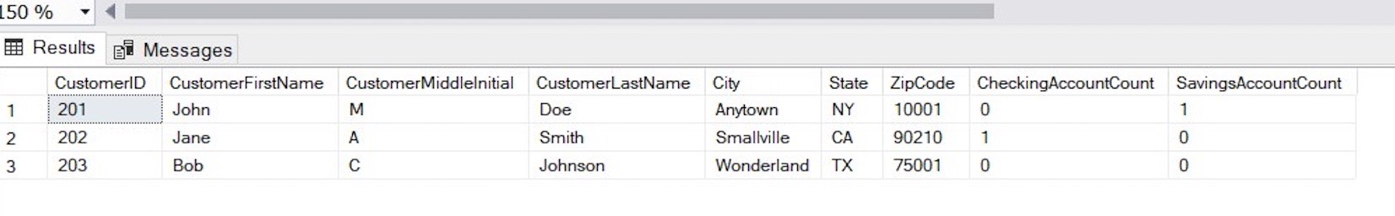
QUESTION THREE QUERY
RESULT

Slide 7
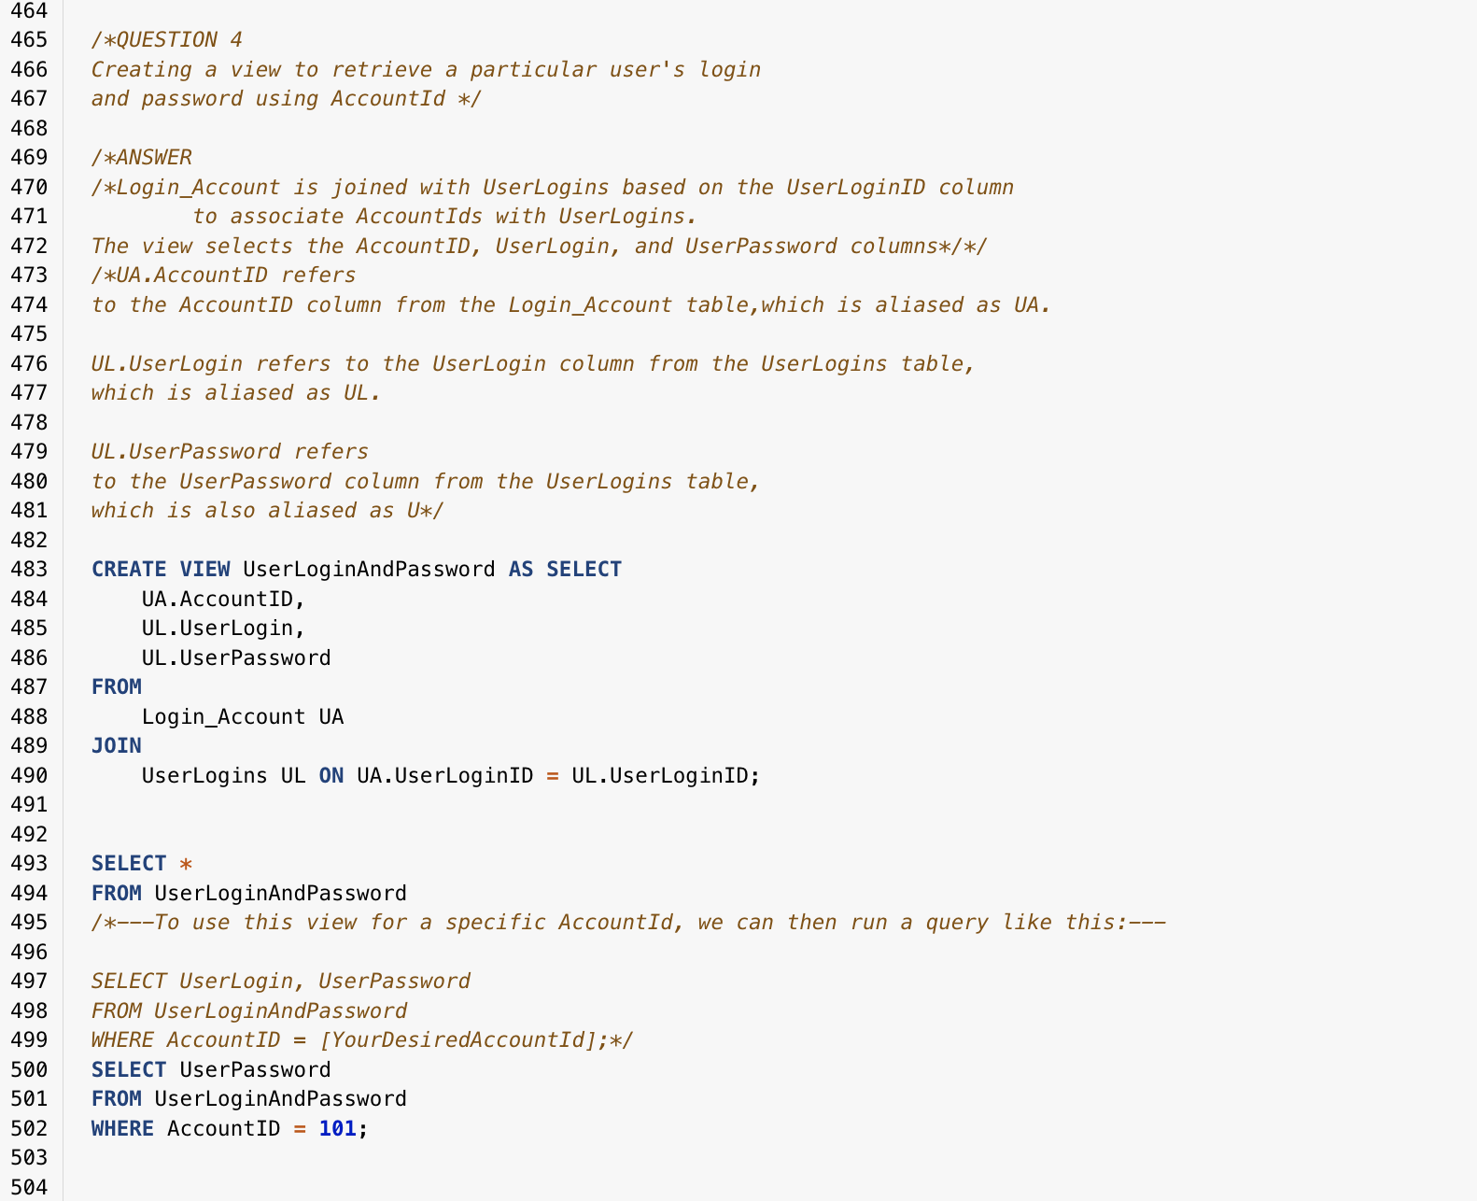
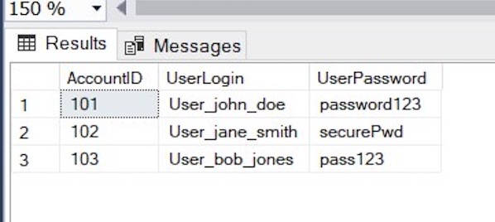
QUESTION FOUR QUERY
RESULT

Slide 8
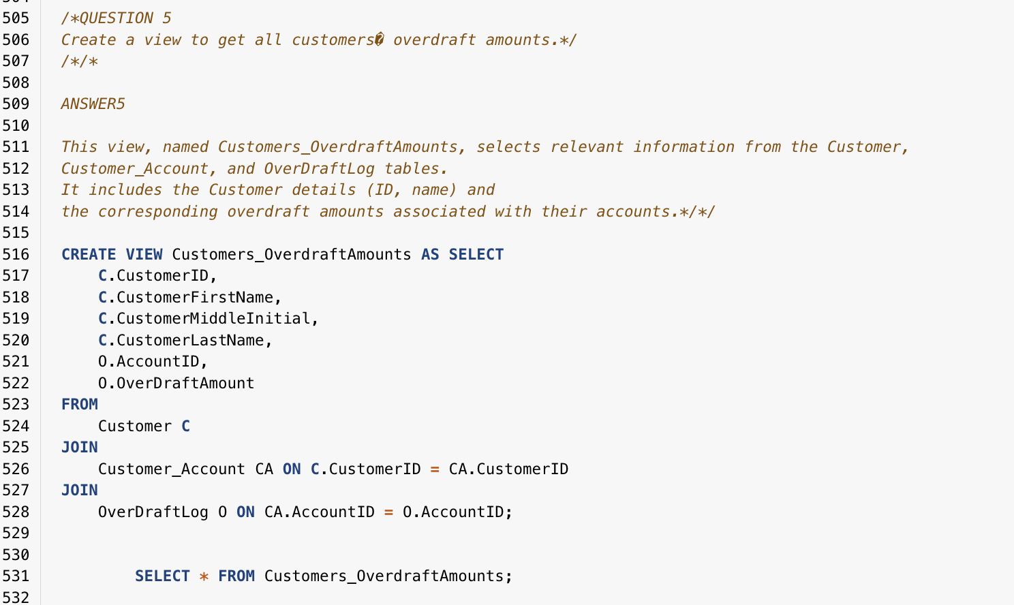
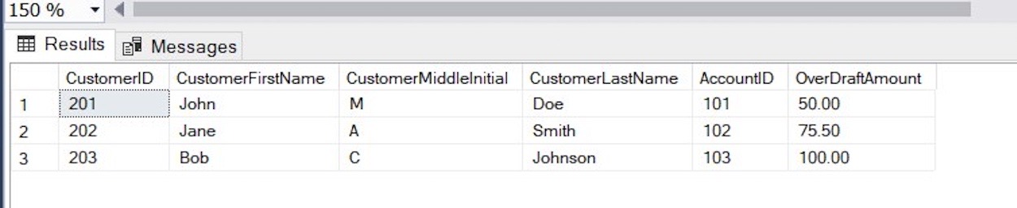
QUESTION FIVE QUERY
RESULT

Slide 9
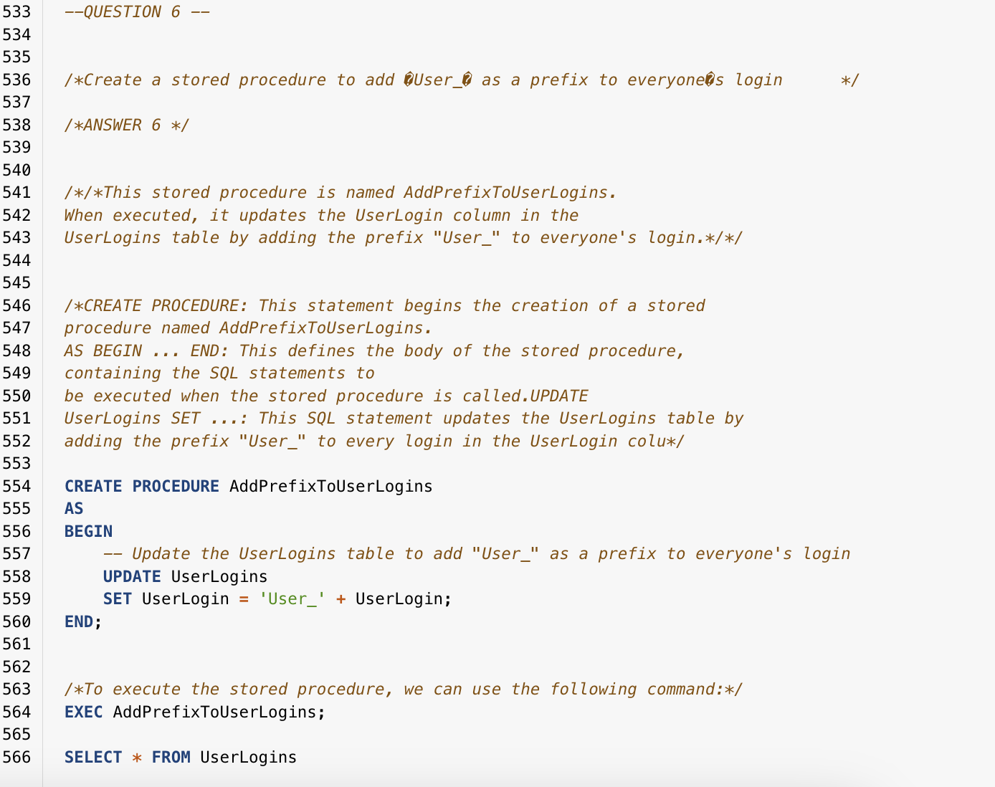
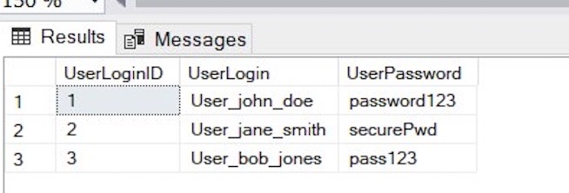
QUESTION SIX QUERY
RESULT

Slide 10

THANK YOU

